Slide 1
Java collection framework

Slide 2
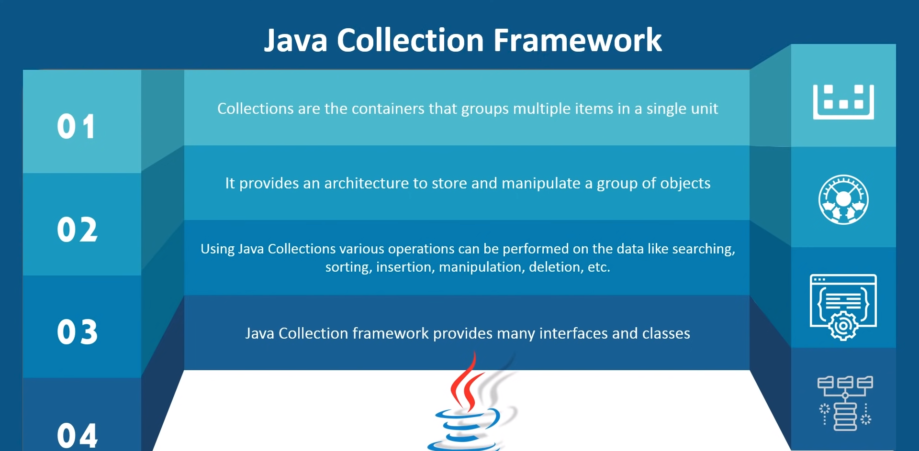
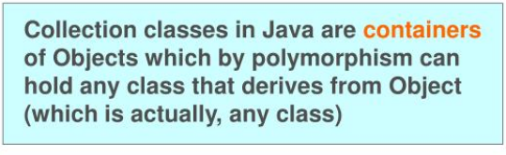
Collection
The Collection framework represents a unified architecture for storing and manipulating a group of objects.
It has:
Interfaces and its implementations, i.e., classes
Algorithm
In Java, a separate framework named the “Collection Framework” has been defined in JDK 1.2 which holds all the collection classes and interface in it.

Slide 3
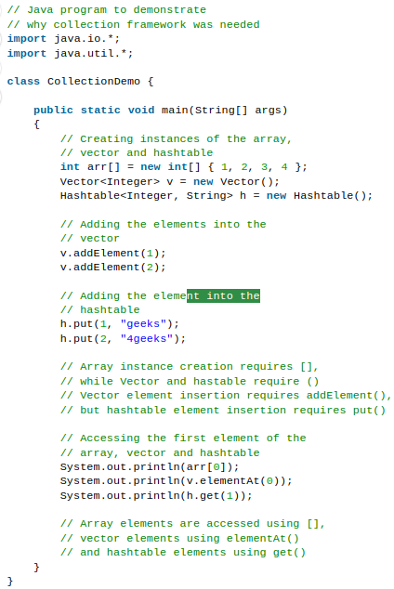
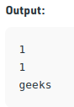
Need for a Separate Collection Framework
Before the Collection Framework(or before JDK 1.2) was introduced, the standard methods for grouping Java objects (or collections) were Arrays or Vectors, or Hashtables.
All of these collections had no common interface.
The implementation of all these collections was defined independently and had no correlation among them.
It's very difficult for the users to remember all the different methods, syntax, and constructors present in every collection class.
In ‘Vector’ most of the methods are final, meaning we cannot extend the ’Vector’ class to implement a similar kind of Collection.
A common interface was needed to deal with above problems.

Slide 4
Advantages of the Collection Framework
Consistent API: The API has a basic set of interfaces like Collection, Set, List, or Map, all the classes (ArrayList, LinkedList, Vector, etc) that implement these interfaces have some common set of methods.
Reduces programming effort: A programmer doesn’t have to worry about the design of the Collection but rather he can focus on its best use in his program. Therefore, the basic concept of Object-oriented programming (i.e.) abstraction has been successfully implemented.
Increases program speed and quality: Increases performance by providing high-performance implementations of useful data structures and algorithms because in this case, the programmer need not think of the best implementation of a specific data structure. He can simply use the best implementation to drastically boost the performance of his algorithm/program.

Slide 5
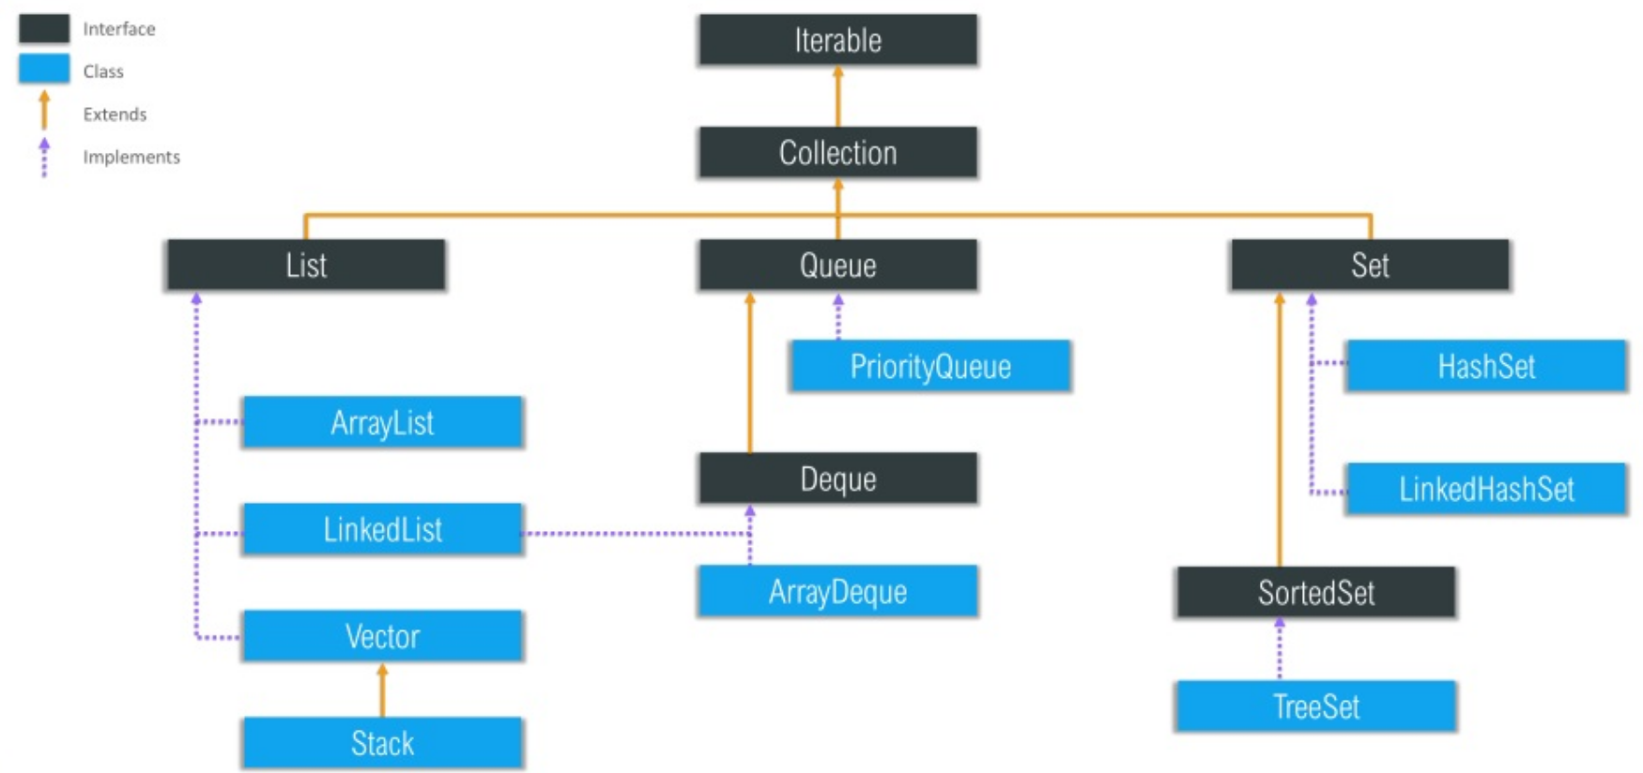
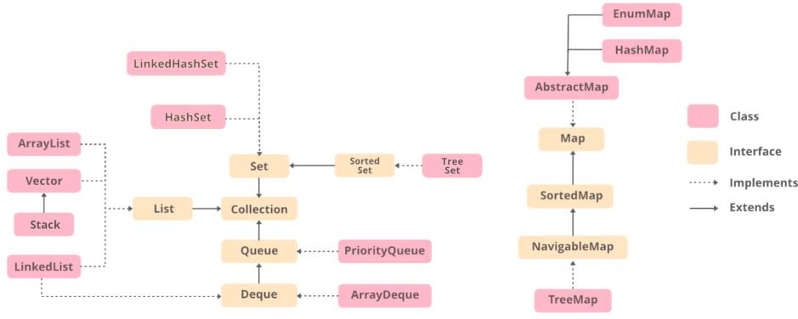
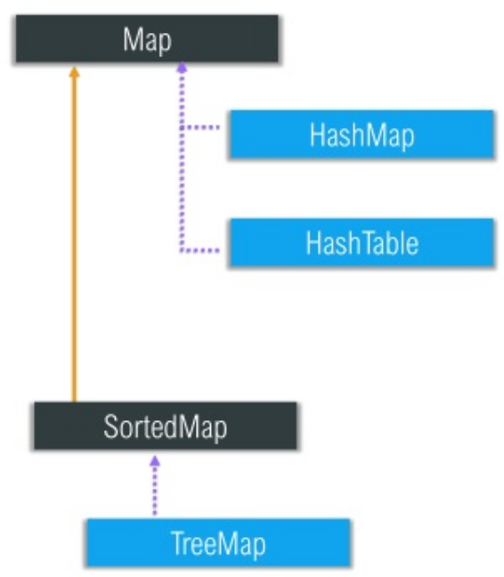
Hierarchy of the Collection Framework
The Collection interface (java.util.Collection) and Map interface (java.util.Map) are the two main “root” interfaces of Java collection classes.
The utility package, (java.util) contains all the classes and interfaces that are required by the collection framework.
The collection framework contains an interface named an iterable interface which provides the iterator to iterate through all the collections.
This interface is extended by the main collection interface which acts as a root for the collection framework.
All the collections extend this collection interface thereby extending the properties of the iterator and the methods of this interface.
Class: A class is a user-defined blueprint or prototype from which objects are created. It represents the set of properties or methods that are common to all objects of one type.
Interface: Like a class, an interface can have methods and variables, but the methods declared in an interface are by default abstract (only method signature, no body). Interfaces specify what a class must do and not how. It is the blueprint of the class.

Slide 6
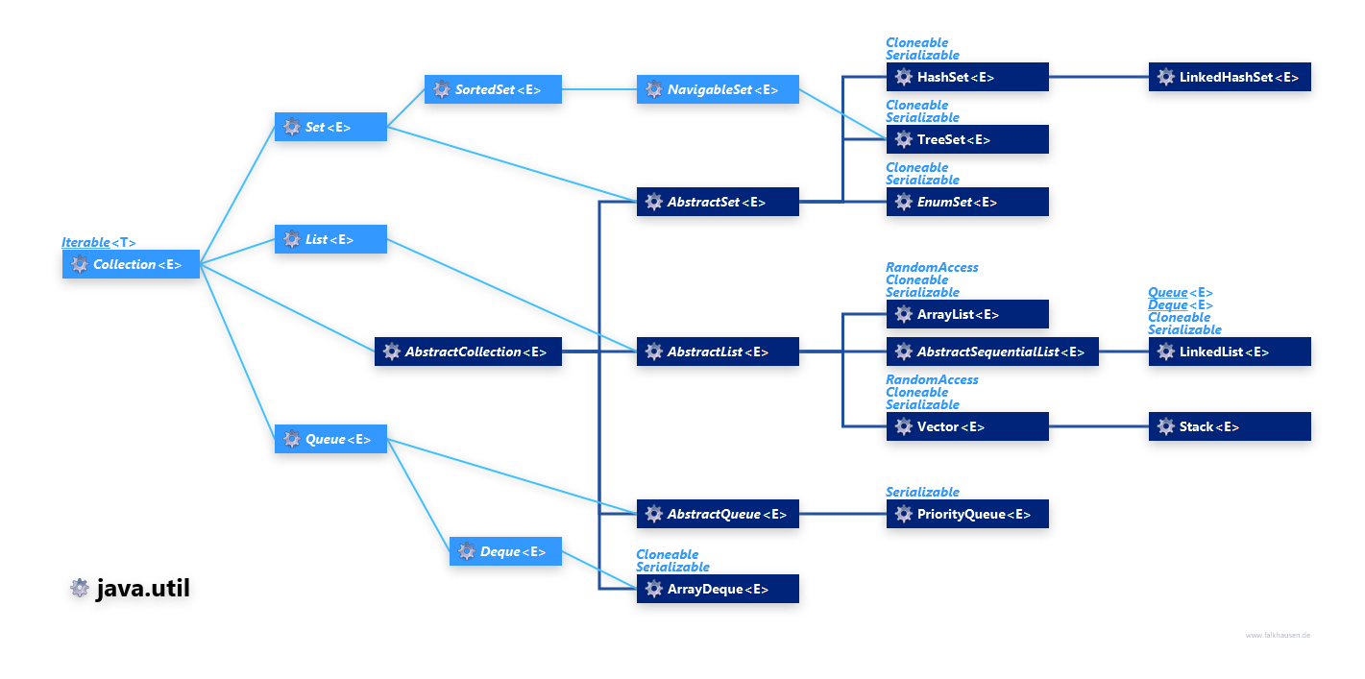
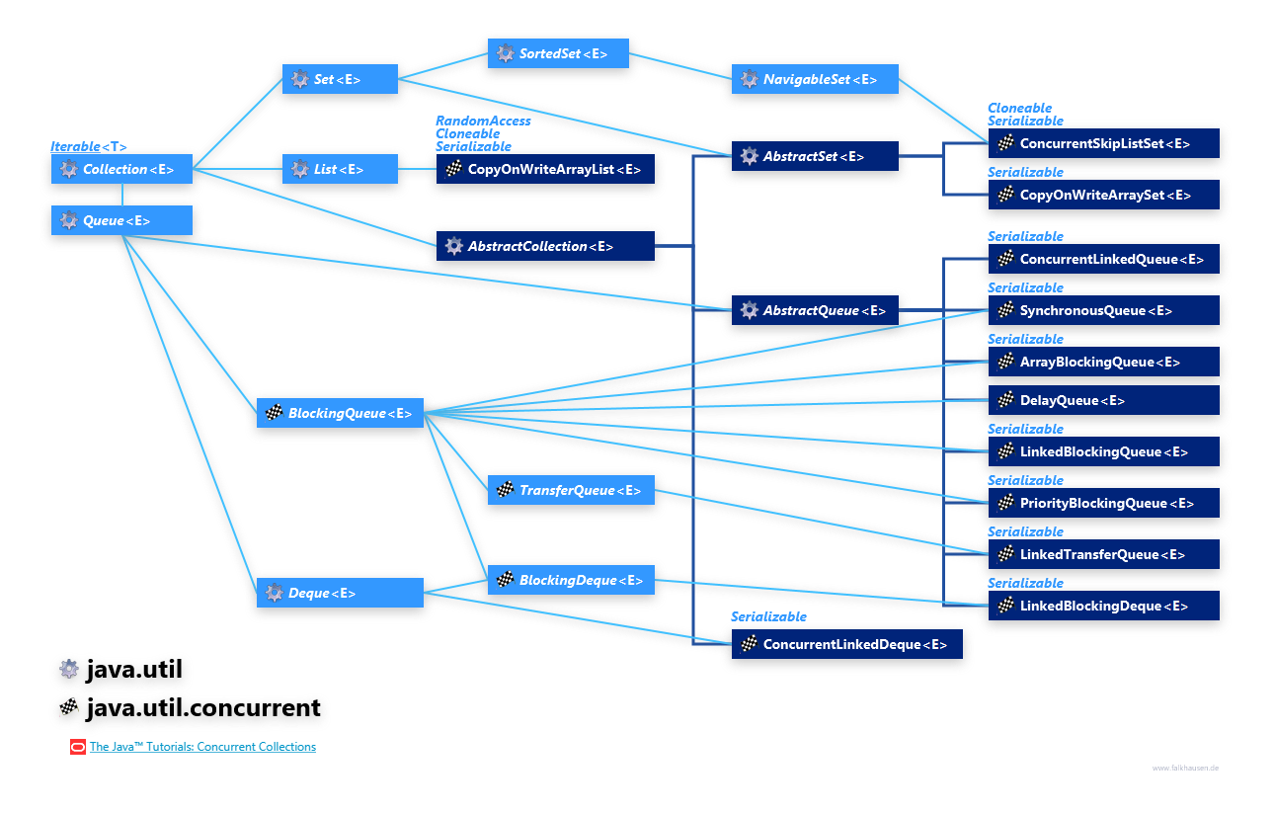



Slide 7
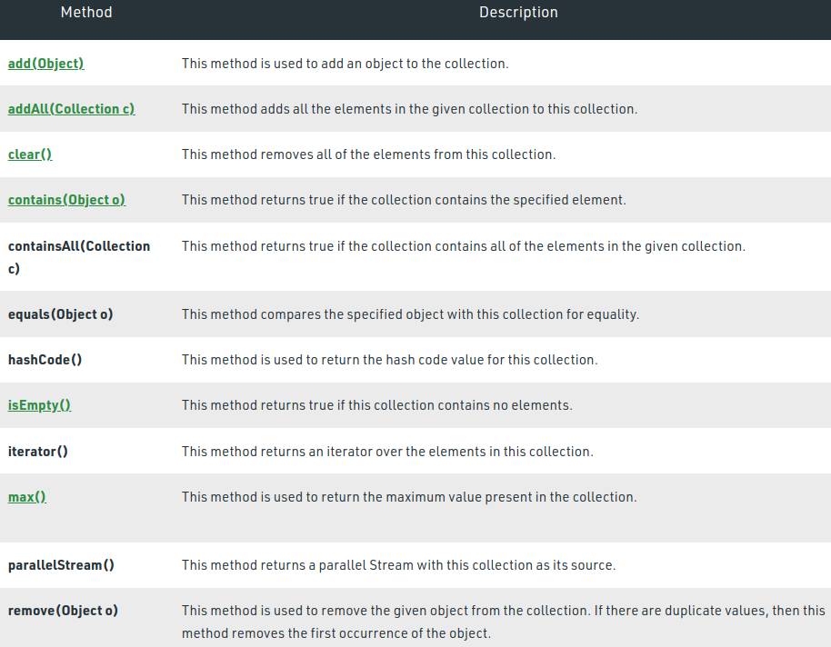
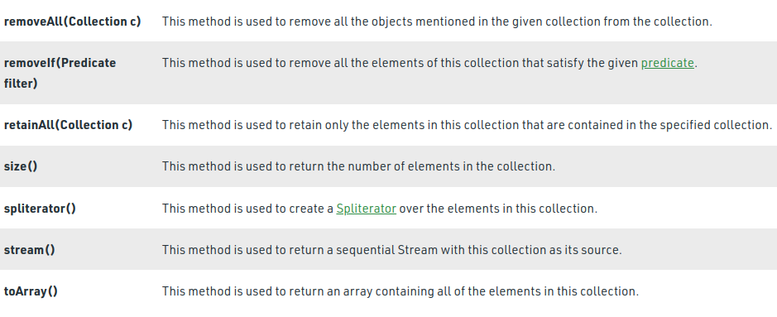
Methods of the Collection Interface

Slide 8
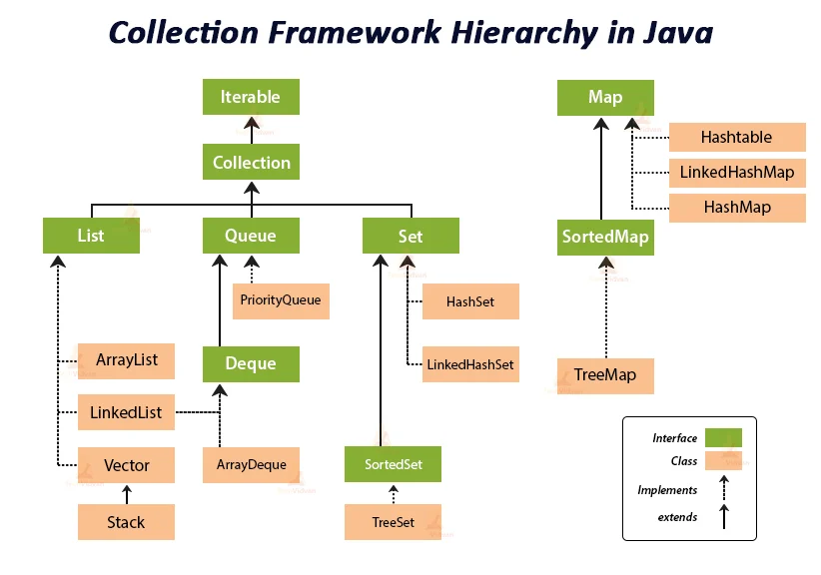
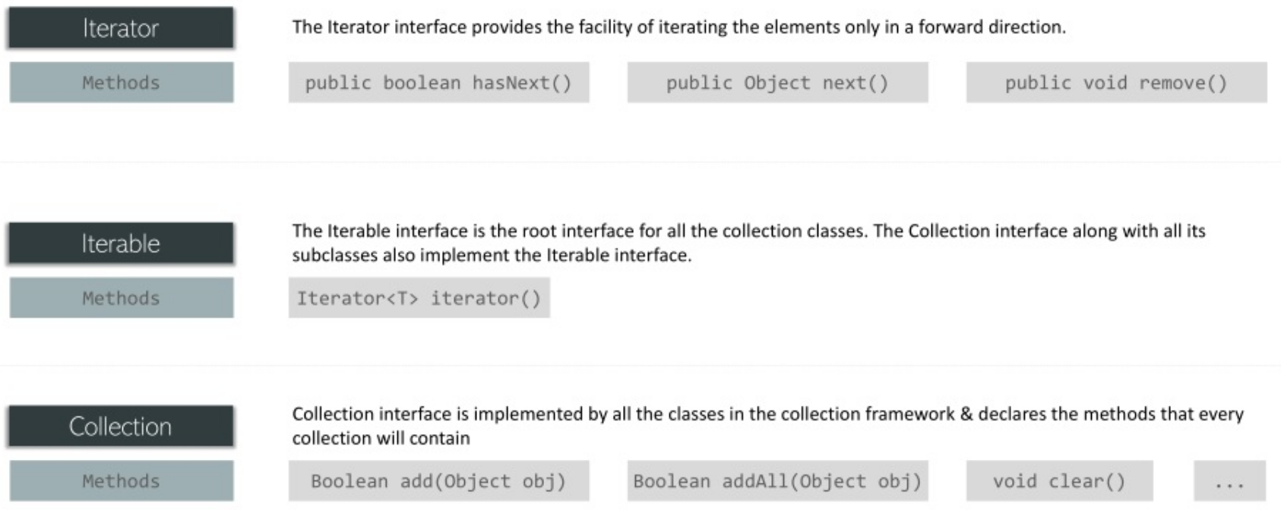
Interfaces that extend the Collection Interface
The collection framework contains multiple interfaces where every interface is used to store a specific type of data. The following are the interfaces present in the framework.
1. Iterable Interface: This is the root interface for the entire collection framework. The collection interface extends the iterable interface.
All the interfaces and classes implement this interface.
The main functionality of this interface is to provide an iterator for the collections. Therefore, this interface contains only one abstract method which is the iterator.
Iterator iterator();
2. Collection Interface: This interface extends the iterable interface and is implemented by all the classes in the collection framework.
This interface contains all the basic methods which every collection has like adding the data into the collection, removing the data, clearing the data, etc.
All these methods are implemented in this interface because these methods are implemented by all the classes irrespective of their style of implementation. And also, having these methods in this interface ensures that the names of the methods are universal for all the collections.
we can say that this interface builds a foundation on which the collection classes are implemented.

Slide 9
Interfaces that extend the Collection Interface
3. List Interface: This is a child interface of the collection interface. This interface is dedicated to the data of the list type in which we can store all the ordered collection of the objects.
This also allows duplicate data to be present in it.
The list interface is implemented by various classes like ArrayList, Vector, Stack, etc. Since all the subclasses implement the list.
we can instantiate a list object with any of these classes. For example,
List <T> al = new ArrayList<> ();
List <T> ll = new LinkedList<> ();
List <T> v = new Vector<> ();
Where T is the type of the object

Slide 10
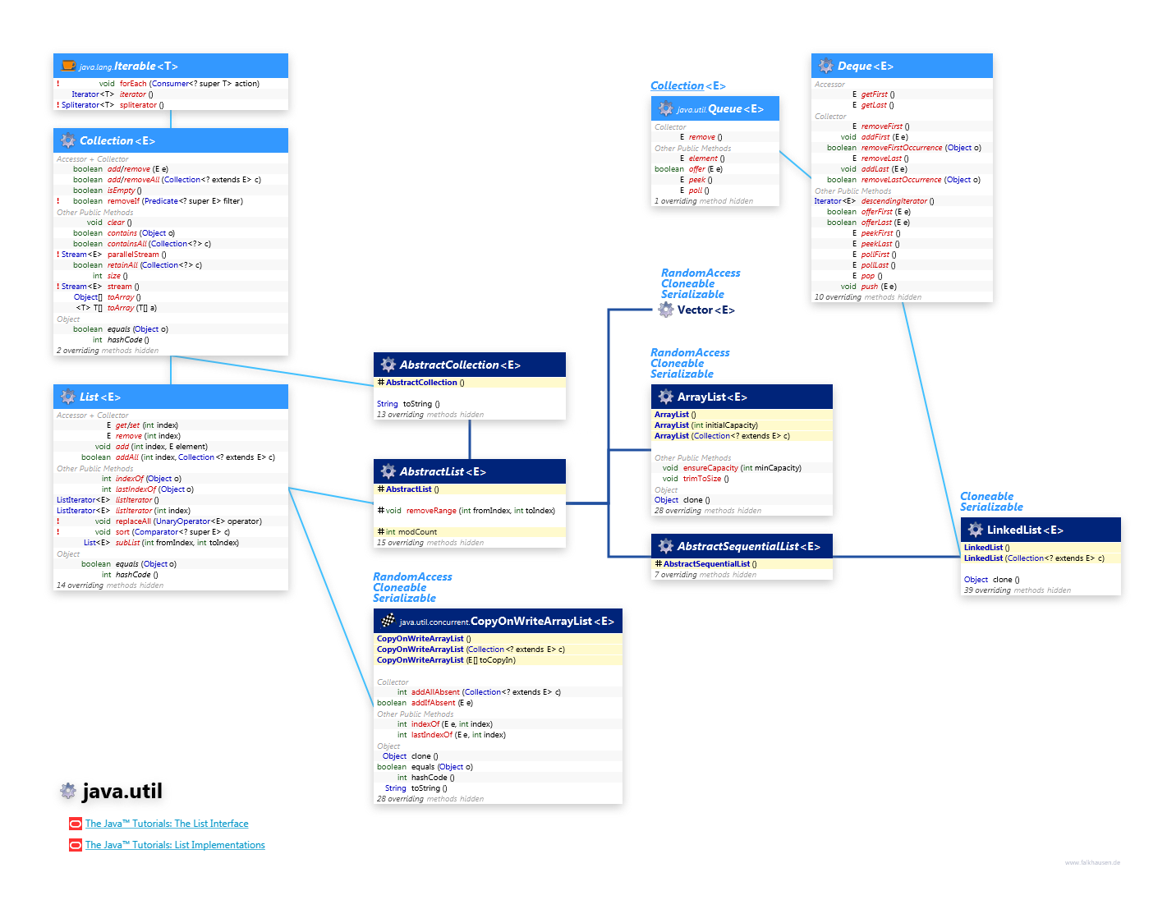

Slide 11
The classes which implement the List interface
A. ArrayList
B. LinkedList
C. Vector
D. Stack

Slide 12
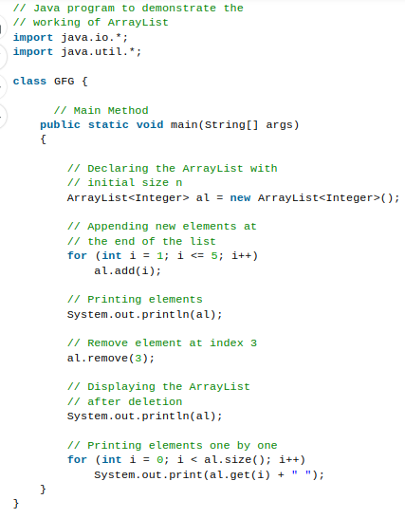
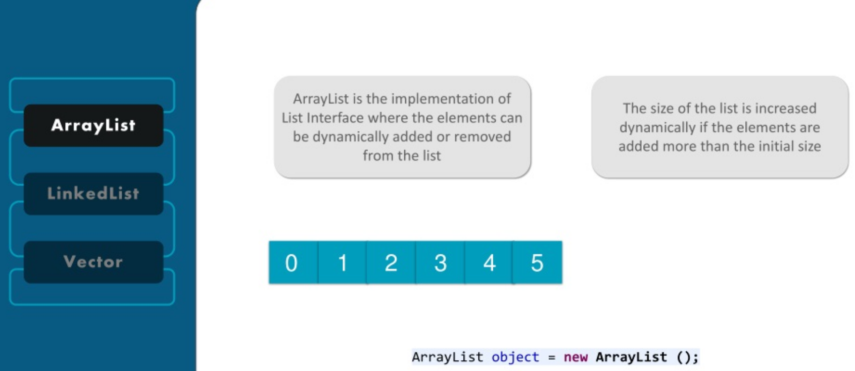
ArrayList
ArrayList provides us with dynamic arrays in Java.
Its slower than standard arrays but can be helpful in programs where lots of manipulation in the array is needed.
The size of an ArrayList is increased automatically if the collection grows or shrinks if the objects are removed from the collection.
Java ArrayList allows us to randomly access the list. ArrayList can not be used for primitive types, like int, char, etc. We will need a wrapper class for such cases
Output:
[1, 2, 3, 4, 5]
[1, 2, 3, 5]
1 2 3 5

Slide 13
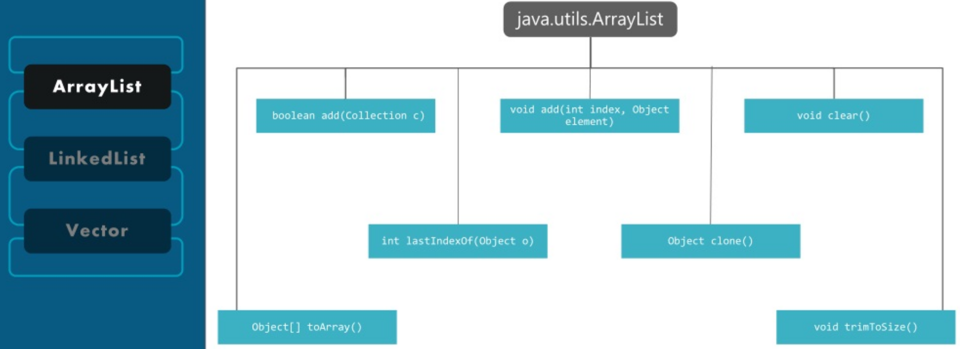

Slide 14
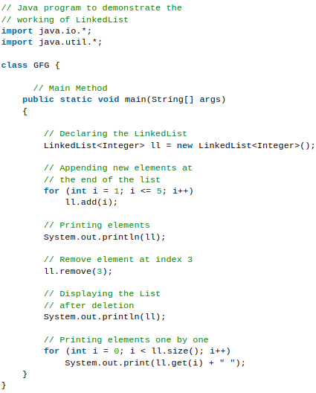
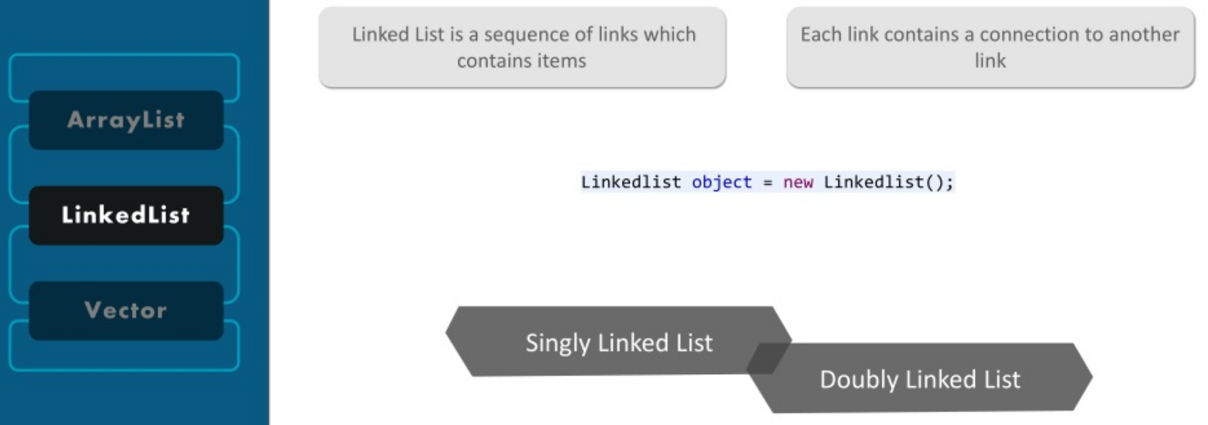
LinkedList
LinkedList class is an implementation of the LinkedList data structure which is a linear data structure where the elements are not stored in contiguous locations and every element is a separate object with a data part and address part.
The elements are linked using pointers and addresses. Each element is known as a node.
Output:
[1, 2, 3, 4, 5]
[1, 2, 3, 5]
1 2 3 5

Slide 15
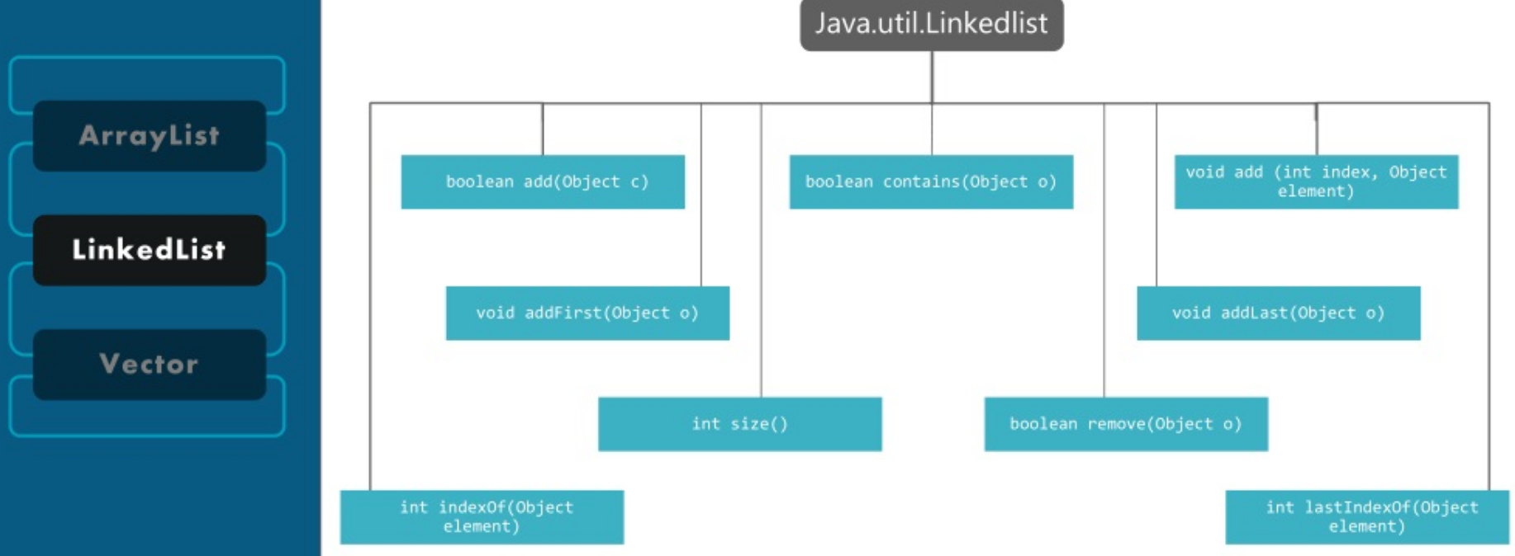

Slide 16
List Algorithms
The polymorphic algorithms described here are pieces of reusable functionality provided by the Java platform. All of them come from the Collections class, and all take the form of static methods whose first argument is the collection on which the operation is to be performed. The great majority of the algorithms provided by the Java platform operate on List instances.
Sorting: The sort algorithm reorders a List so that its elements are in ascending order according to an ordering relationship. Two forms of the operation are provided. The simple form takes a List and sorts it according to its elements' natural ordering. The sort operation uses a slightly optimized merge sort algorithm that is fast and stable.
Shuffling : The shuffle algorithm does the opposite of what sort does, destroying any trace of order that may have been present in a List. That is, this algorithm reorders the List based on input from a source of randomness such that all possible permutations occur with equal likelihood, assuming a fair source of randomness. This algorithm is useful in implementing games of chance.
Routine Data Manipulation
The Collections class provides five algorithms for doing routine data manipulation on List objects, all of which are pretty straightforward:
reverse — reverses the order of the elements in a List.
fill — overwrites every element in a List with the specified value. This operation is useful for reinitializing a List.
copy — takes two arguments, a destination List and a source List, and copies the elements of the source into the destination, overwriting its contents. The destination List must be at least as long as the source. If it is longer, the remaining elements in the destination List are unaffected.
swap — swaps the elements at the specified positions in a List.
addAll — adds all the specified elements to a Collection. The elements to be added may be specified individually or as an array.
Searching : The binarySearch algorithm searches for a specified element in a sorted List. This algorithm has two forms. The first takes a List and an element to search for (the "search key"). This form assumes that the List is sorted in ascending order according to the natural ordering of its elements. The second form takes a Comparator in addition to the List and the search key, and assumes that the List is sorted into ascending order according to the specified Comparator. The sort algorithm can be used to sort the List prior to calling binarySearch.
Most polymorphic algorithms in the Collections class apply specifically to List. Having all these algorithms at your disposal makes it very easy to manipulate lists.
sort — sorts a List using a merge sort algorithm, which provides a fast, stable sort. (A stable sort is one that does not reorder equal elements.)
shuffle — randomly permutes the elements in a List.
reverse — reverses the order of the elements in a List.
rotate — rotates all the elements in a List by a specified distance.
swap — swaps the elements at specified positions in a List.
replaceAll — replaces all occurrences of one specified value with another.
fill — overwrites every element in a List with the specified value.
copy — copies the source List into the destination List.
binarySearch — searches for an element in an ordered List using the binary search algorithm.
indexOfSubList — returns the index of the first sublist of one List that is equal to another.
lastIndexOfSubList — returns the index of the last sublist of one List that is equal to another.
https://docs.oracle.com/javase/tutorial/collections/algorithms/index.html

Slide 17
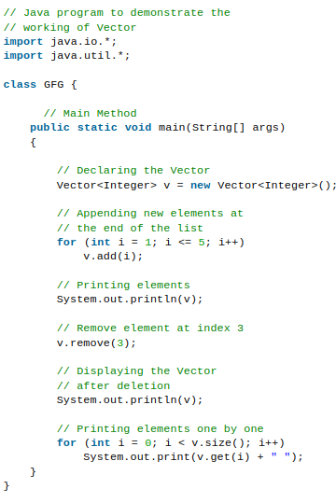
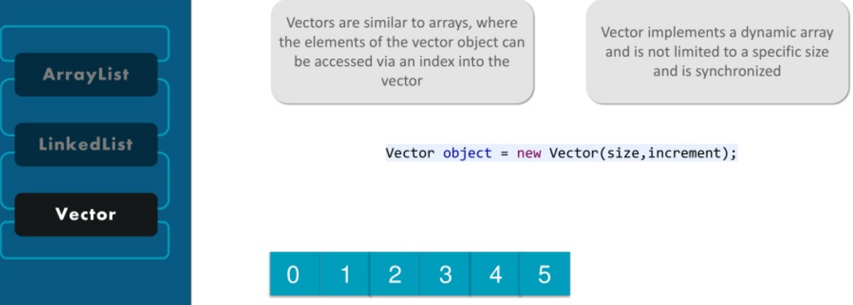
vector
A vector provides us with dynamic arrays in Java.
Its slower than standard arrays but can be helpful in programs where lots of manipulation in the array is needed. This is identical to ArrayList in terms of implementation.
The primary difference between a vector and an ArrayList is that a Vector is synchronized and an ArrayList is non-synchronized
Output:
[1, 2, 3, 4, 5]
[1, 2, 3, 5]
1 2 3 5

Slide 18
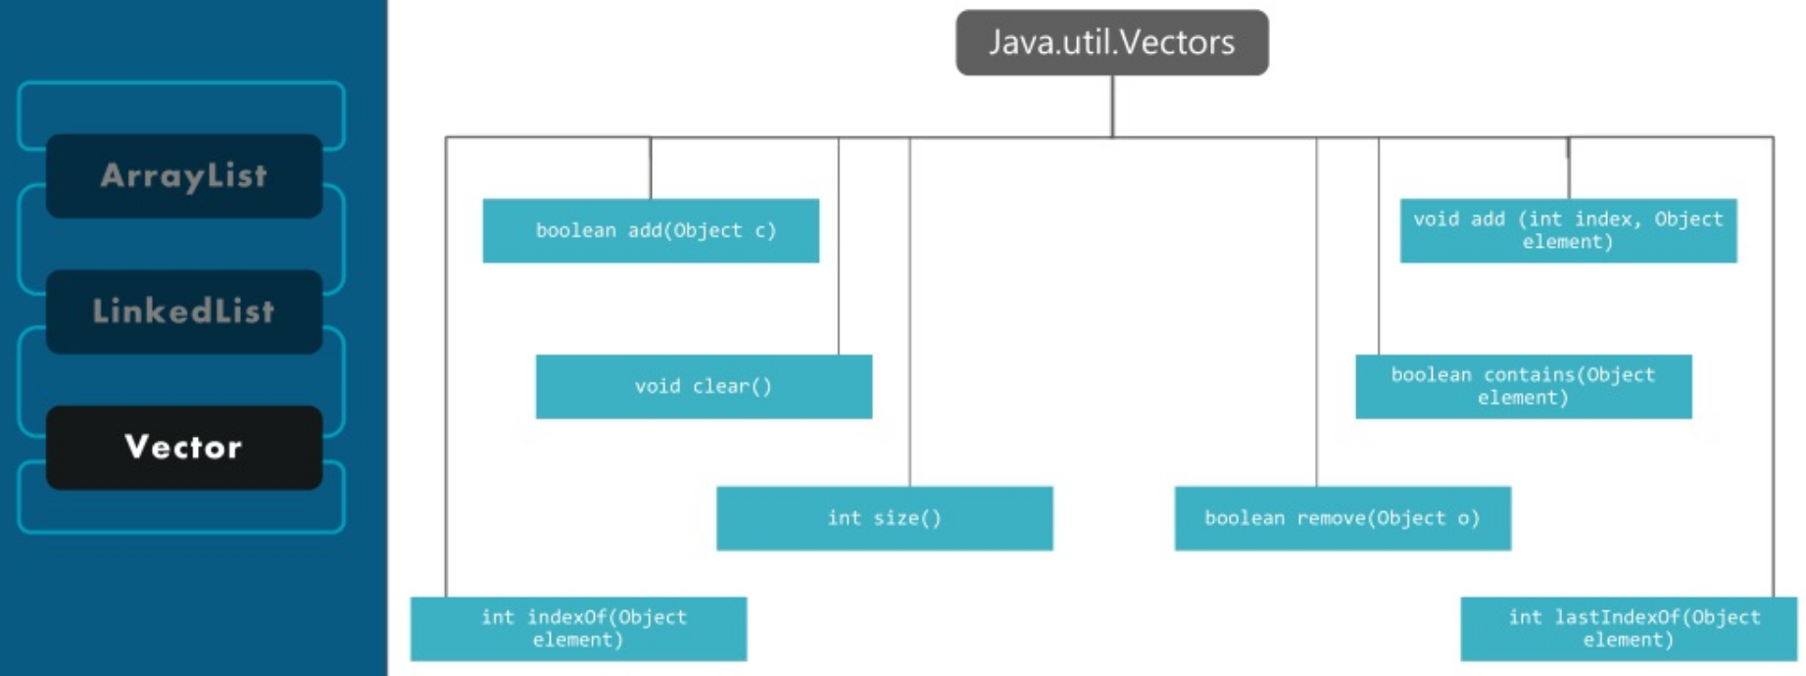

Slide 19
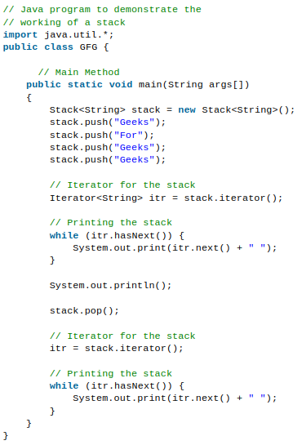
Stack
Stack class models and implements the Stack data structure.
The class is based on the basic principle of last-in-first-out.
In addition to the basic push and pop operations, the class provides three more functions of empty, search and peek.
The class can also be referred to as the subclass of Vector.
Output:
Geeks For Geeks Geeks
Geeks For Geeks
Note: Stack is a subclass of Vector and a legacy class. It is thread-safe which might be overhead in an environment where thread safety is not needed. An alternate to Stack is to use ArrayDequeue which is not thread-safe and has faster array implementation.

Slide 20
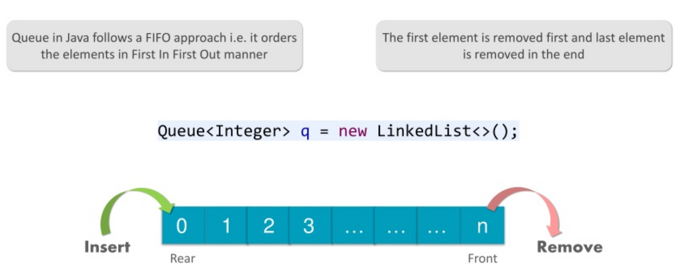
Interfaces that extend the Collection Interface
4. Queue Interface: As the name suggests, a queue interface maintains the FIFO(First In First Out) order similar to a real-world queue line.
This interface is dedicated to storing all the elements where the order of the elements matter. For example, whenever we try to book a ticket, the tickets are sold on a first come first serve basis. Therefore, the person whose request arrives first into the queue gets the ticket. There are various classes like PriorityQueue, ArrayDeque, etc. Since all these subclasses implement the queue, we can instantiate a queue object with any of these classes. For example,
Queue <T> pq = new PriorityQueue<> ();
Queue <T> ad = new ArrayDeque<> ();
Where T is the type of the object.

Slide 21
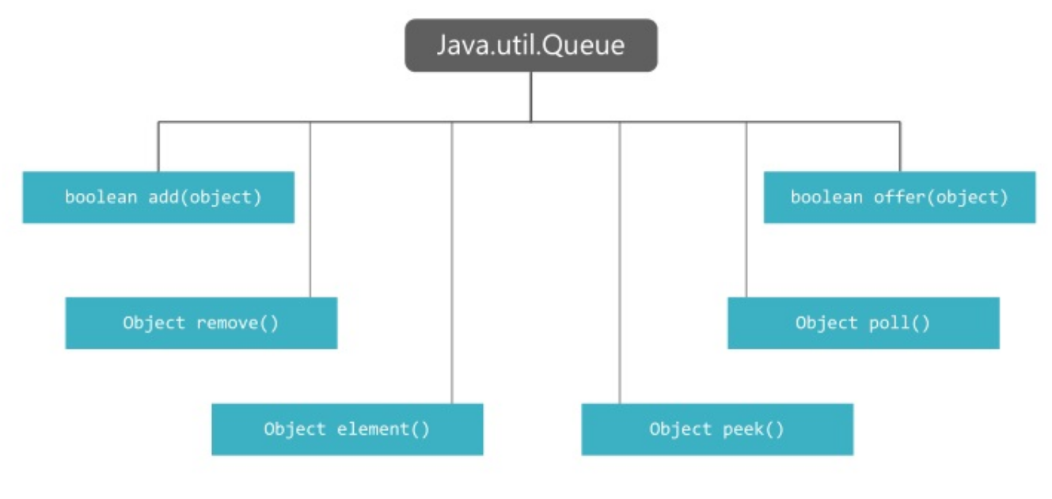

Slide 22
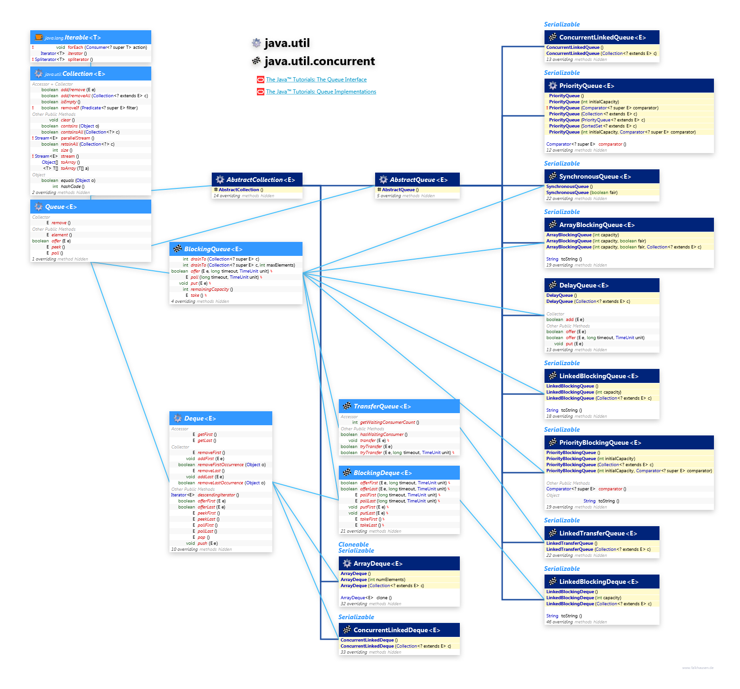

Slide 23
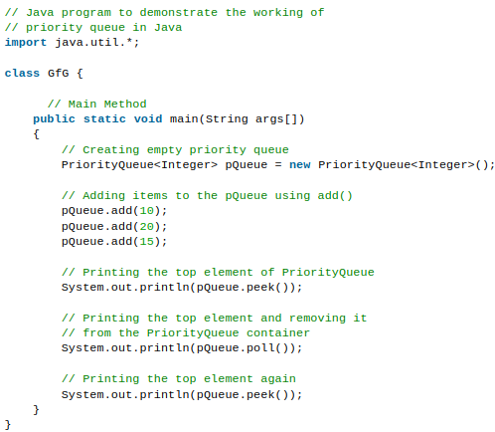
PriorityQueue
A PriorityQueue is used when the objects are supposed to be processed based on the priority. It is known that a queue follows the First-In-First-Out algorithm, but sometimes the elements of the queue are needed to be processed according to the priority and this class is used in these cases. The PriorityQueue is based on the priority heap. The elements of the priority queue are ordered according to the natural ordering, or by a Comparator provided at queue construction time, depending on which constructor is used.
Output:
10
10
15

Slide 24
Interfaces that extend the Collection Interface
5. Deque Interface: This is a very slight variation of the queue data structure. Deque, also known as a double-ended queue, is a data structure where we can add and remove the elements from both ends of the queue. This interface extends the queue interface. The class which implements this interface is ArrayDeque. Since ArrayDeque class implements the Deque interface, we can instantiate a deque object with this class. For example,
Deque<T> ad = new ArrayDeque<> ();
Where T is the type of the object.

Slide 25
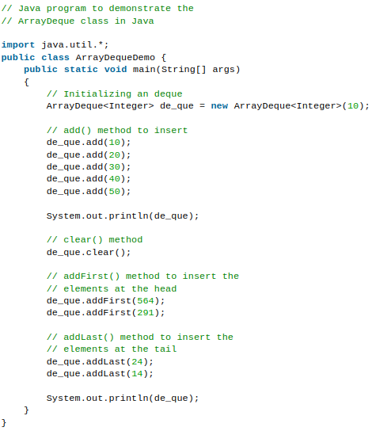
ArrayDeque
ArrayDeque class which is implemented in the collection framework provides us with a way to apply resizable-array.
It's a special kind of array that grows and allows users to add or remove an element from both sides of the queue.
Array deques have no capacity restrictions and they grow as necessary to support usage.
Output:
[10, 20, 30, 40, 50]
[291, 564, 24, 14]

Slide 26
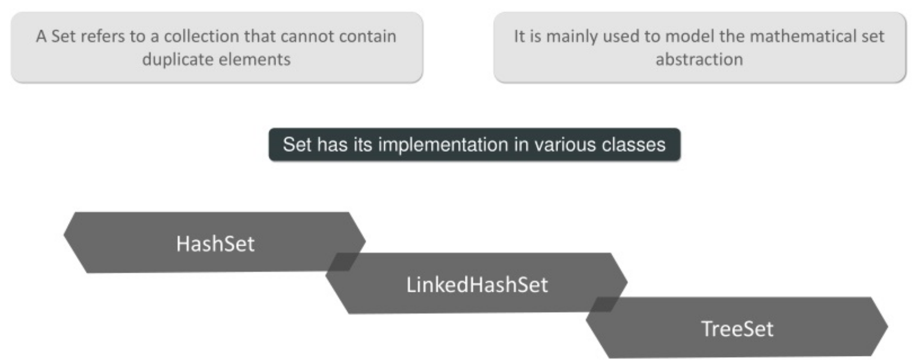
Interfaces that extend the Collection Interface
6. Set Interface: A set is an unordered collection of objects in which duplicate values cannot be stored. This collection is used when we wish to avoid the duplication of the objects and wish to store only the unique objects. This set interface is implemented by various classes like HashSet, TreeSet, LinkedHashSet, etc. Since all the subclasses implement the set, we can instantiate a set object with any of these classes. For example,
Set<T> hs = new HashSet<> ();
Set<T> lhs = new LinkedHashSet<> ();
Set<T> ts = new TreeSet<> ();
Where T is the type of the object.

Slide 27
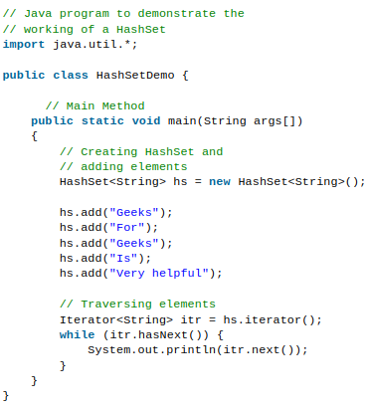
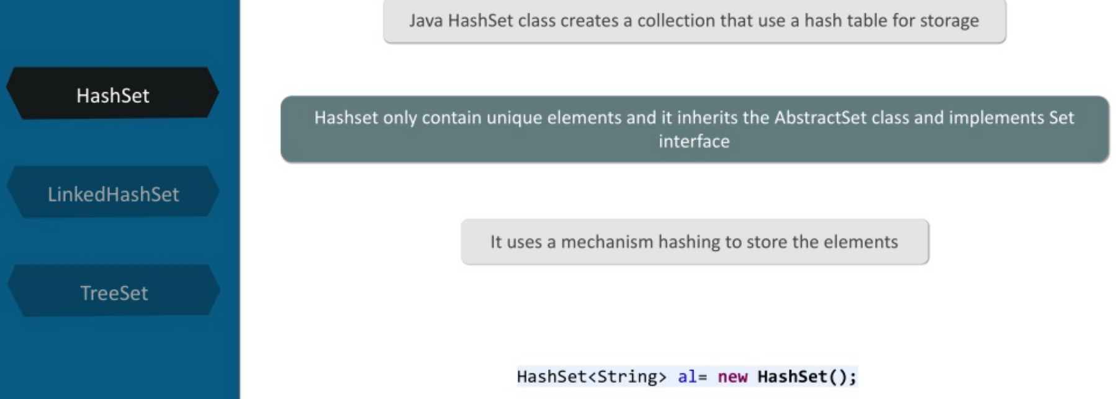
HashSet
The HashSet class is an inherent implementation of the hash table data structure. The objects that we insert into the HashSet do not guarantee to be inserted in the same order. The objects are inserted based on their hashcode. This class also allows the insertion of NULL elements.
Output:
Very helpful
Geeks
For
Is

Slide 28
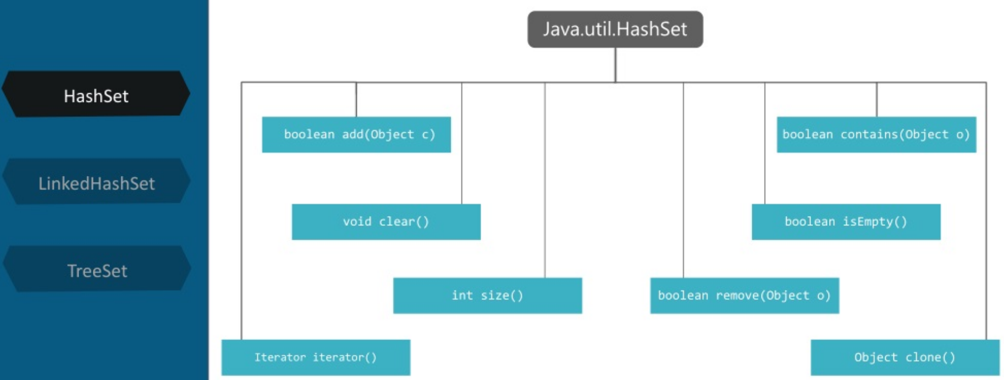

Slide 29
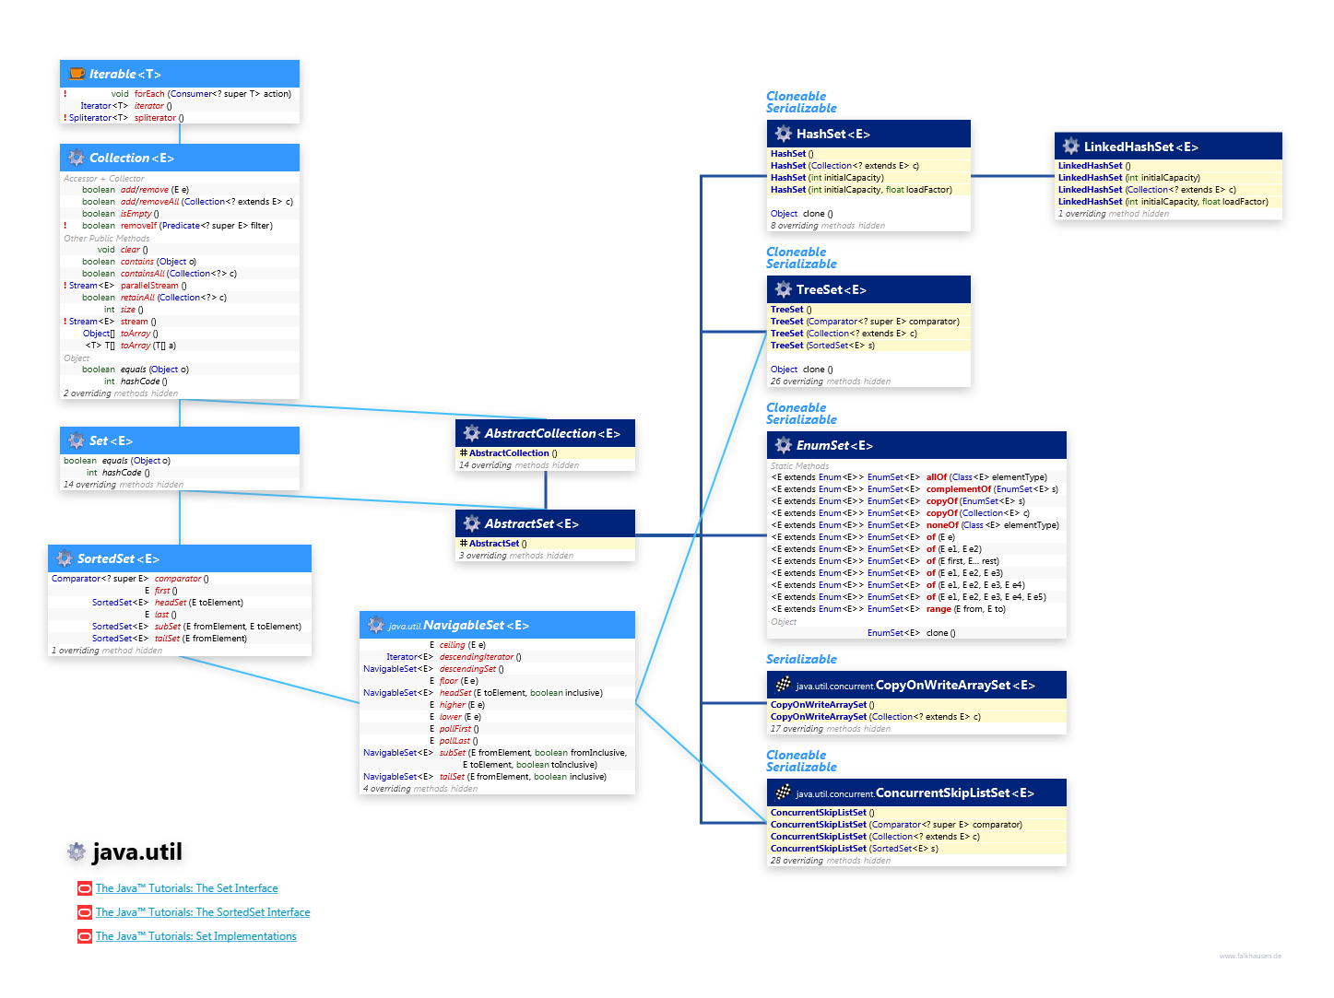

Slide 30
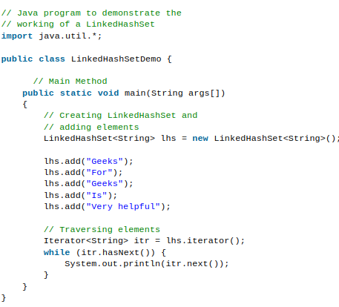
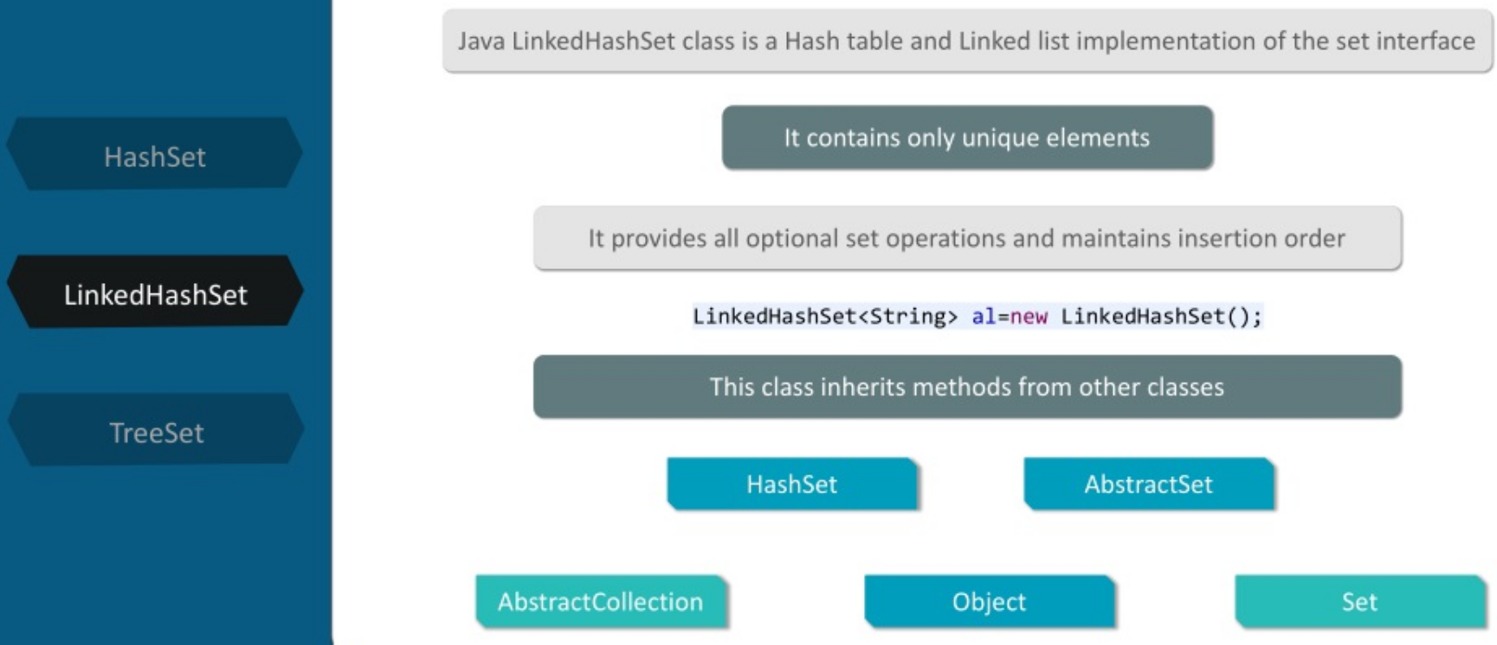
LinkedHashSet
A LinkedHashSet is very similar to a HashSet. The difference is that this uses a doubly linked list to store the data and retains the ordering of the elements.
Output:
Geeks
For
Is
Very helpful

Slide 31
Interfaces that extend the Collection Interface
7. Sorted Set Interface: This interface is very similar to the set interface. The only difference is that this interface has extra methods that maintain the ordering of the elements. The sorted set interface extends the set interface and is used to handle the data which needs to be sorted. The class which implements this interface is TreeSet. Since this class implements the SortedSet, we can instantiate a SortedSet object with this class. For example,
SortedSet<T> ts = new TreeSet<> ();
Where T is the type of the object.

Slide 32
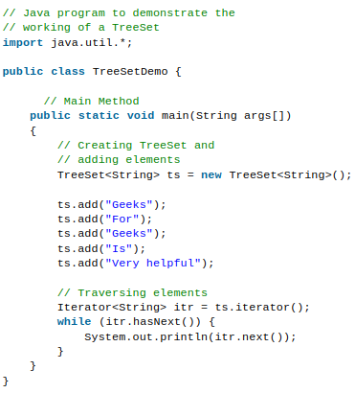
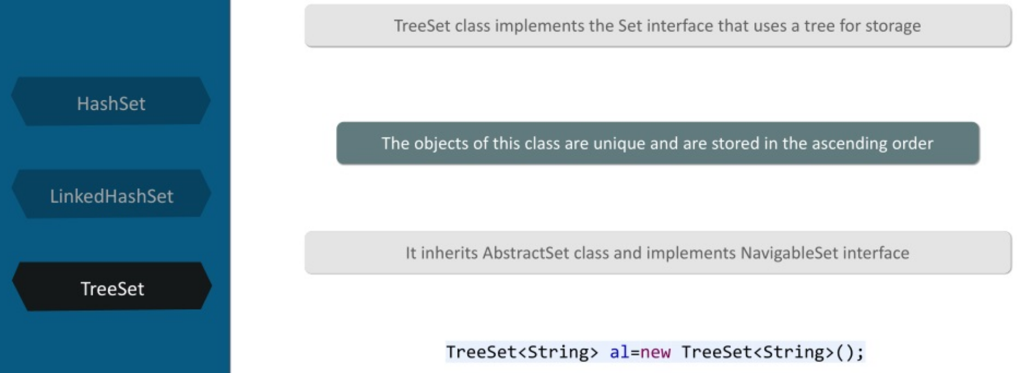
TreeSet
The TreeSet class uses a Tree for storage. The ordering of the elements is maintained by a set using their natural ordering whether or not an explicit comparator is provided. This must be consistent with equals if it is to correctly implement the Set interface. It can also be ordered by a Comparator provided at set creation time, depending on which constructor is used.
Output:
For
Geeks
Is
Very helpful

Slide 33
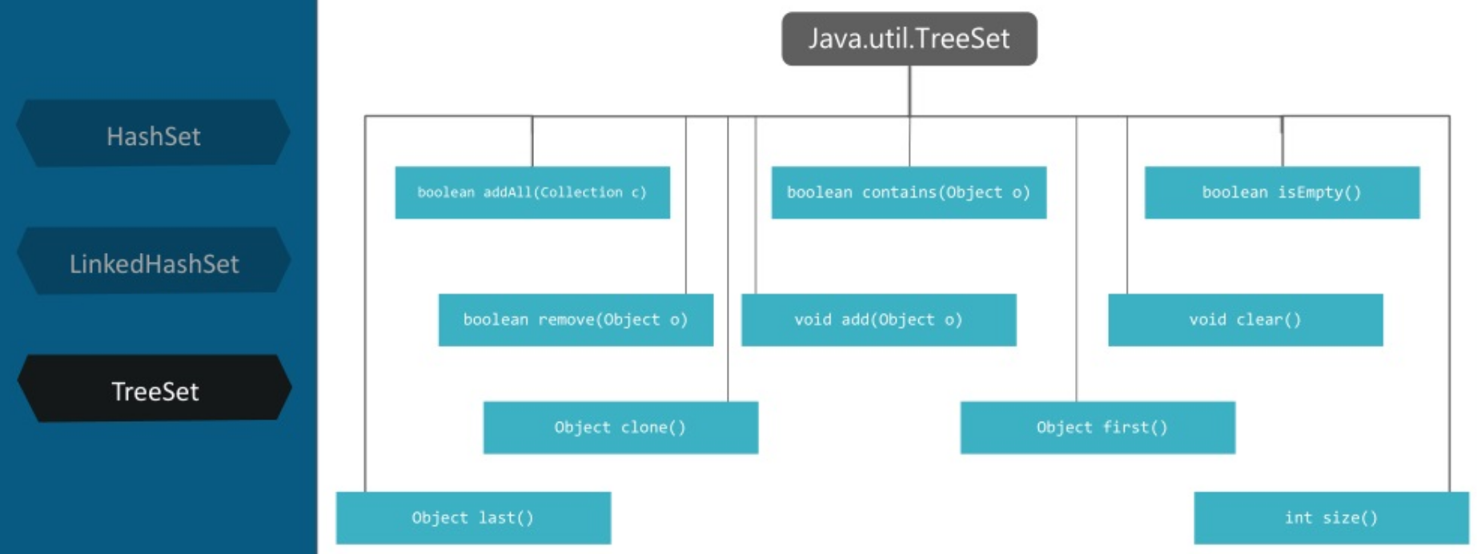

Slide 34
Interfaces that extend the Collection Interface
8. Map Interface: A map is a data structure that supports the key-value pair mapping for the data. This interface doesn’t support duplicate keys because the same key cannot have multiple mappings. A map is useful if there is data and we wish to perform operations on the basis of the key. This map interface is implemented by various classes like HashMap, TreeMap, etc. Since all the subclasses implement the map, we can instantiate a map object with any of these classes. For example,
Map<T> hm = new HashMap<> ();
Map<T> tm = new TreeMap<> ();
Where T is the type of the object.

Slide 35
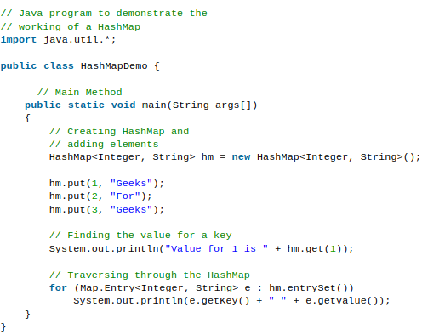
HashMap
HashMap provides the basic implementation of the Map interface of Java. It stores the data in (Key, Value) pairs. To access a value in a HashMap, we must know its key. HashMap uses a technique called Hashing.
Hashing is a technique of converting a large String to a small String that represents the same String so that the indexing and search operations are faster. HashSet also uses HashMap internally.
Output:
Value for 1 is Geeks
1 Geeks
2 For
3 Geeks

Slide 36
Summary of Interfaces
The core collection interfaces are the foundation of the Java Collections Framework.
The Java Collections Framework hierarchy consists of two distinct interface trees:
The first tree starts with the Collection interface, which provides for the basic functionality used by all collections, such as add and remove methods. Its subinterfaces — Set, List, and Queue — provide for more specialized collections.
The Set interface does not allow duplicate elements. This can be useful for storing collections such as a deck of cards or student records. The Set interface has a subinterface, SortedSet, that provides for ordering of elements in the set.
The List interface provides for an ordered collection, for situations in which you need precise control over where each element is inserted. You can retrieve elements from a List by their exact position.
The Queue interface enables additional insertion, extraction, and inspection operations. Elements in a Queue are typically ordered in on a FIFO basis.
The Deque interface enables insertion, deletion, and inspection operations at both the ends. Elements in a Deque can be used in both LIFO and FIFO.
The second tree starts with the Map interface, which maps keys and values similar to a Hashtable.
Map's subinterface, SortedMap, maintains its key-value pairs in ascending order or in an order specified by a Comparator.
These interfaces allow collections to be manipulated independently of the details of their representation.

Slide 37
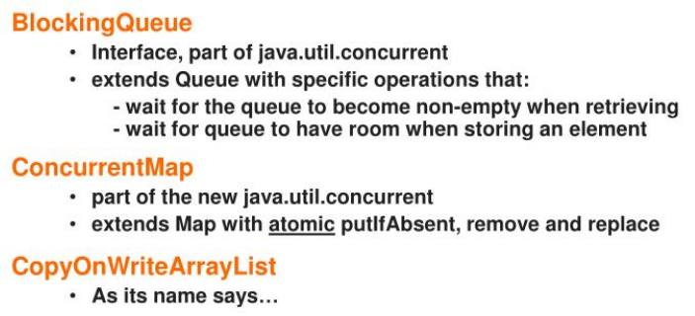
Special Collections
A thread-safe variant of ArrayList in which all mutative operations (add, set, and so on) are implemented by making a fresh copy of the underlying array.
https://docs.oracle.com/javase/6/docs/api/java/util/concurrent/package-summary.html

Slide 38
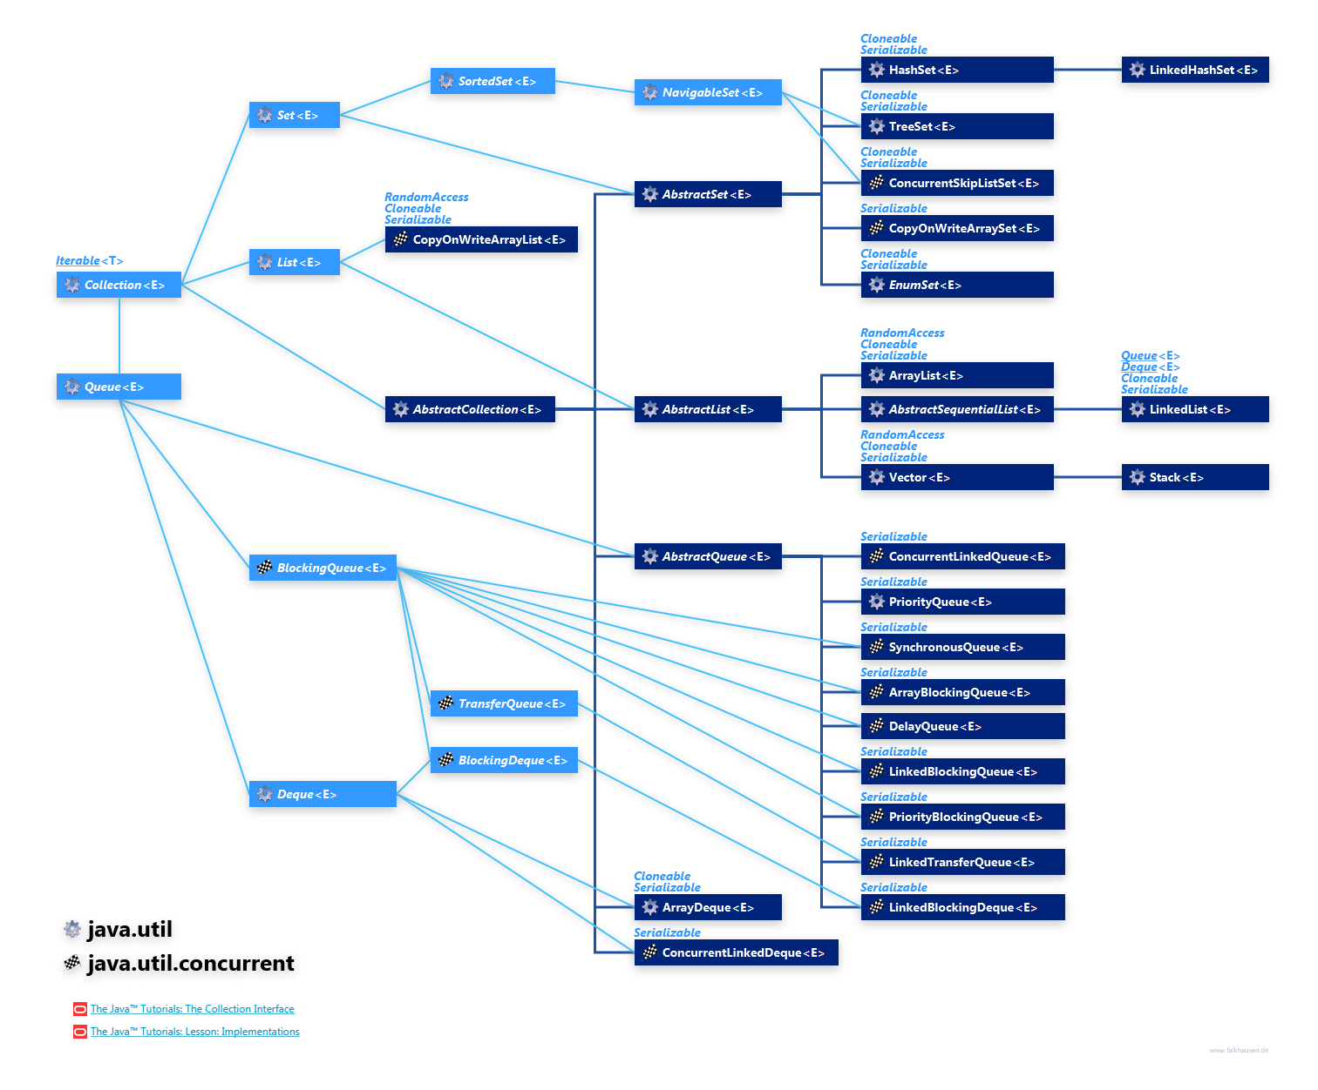
https://www.falkhausen.de/Java-8/java.util/Collection-Hierarchy.html

